Slide 1
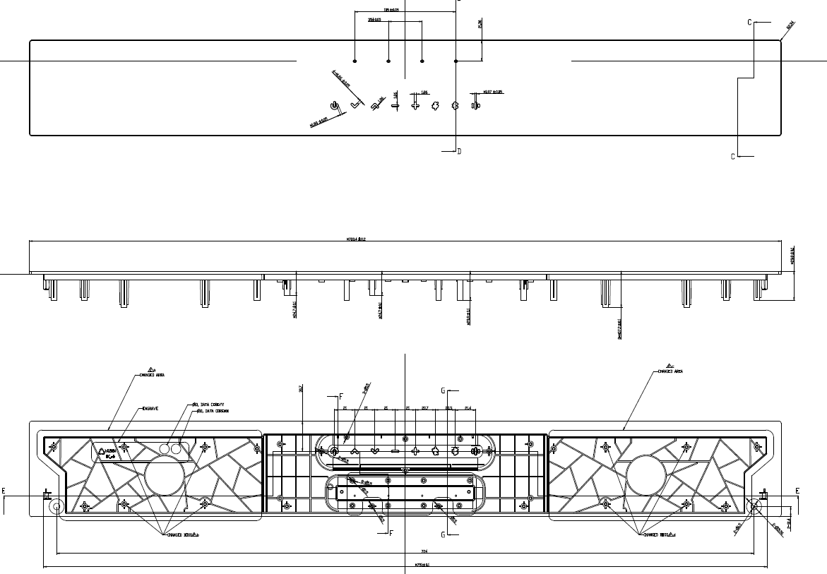
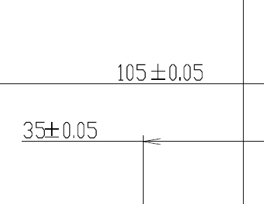
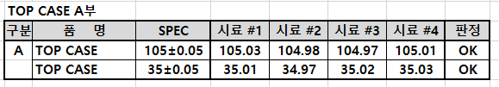
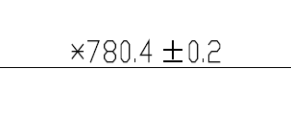

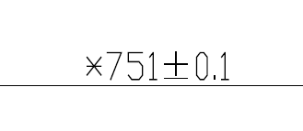

CASE TOP
A부
B부
C부
According to our experience, the Tolerance (+/-0.20mm) for dimension (780.4mm) is unreasonable for such a long size part(and other long sizes). So, we suggest to apply (+/-0.50mm ) tolerance instead for this trial build, but need Inkel to re-define it based on the CPK report coms out after PPR.

Slide 2
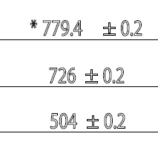
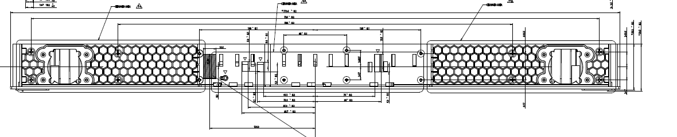
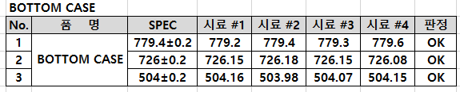
CASE BOTTOM ASS'Y
According to our experience, the Tolerance (+/-0.20mm) for dimension (780.4mm) is unreasonable for such a long size part(and other long sizes). So, we suggest to apply (+/-0.50mm ) tolerance instead for this trial build, but need Inkel to re-define it based on the CPK report coms out after PPR.

Slide 3
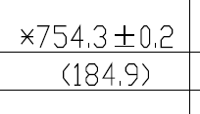
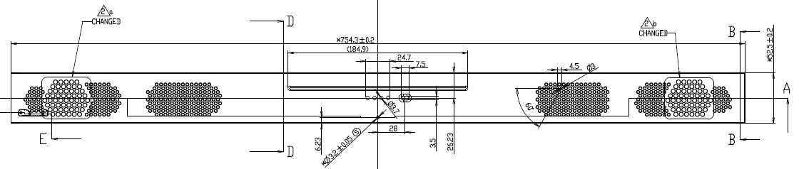
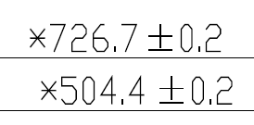
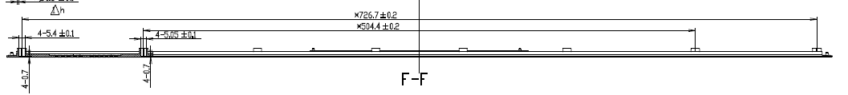

GRILL FABRIC ASS'Y
A부
A is can not measure due to sub assembly
B부
According to our experience, the Tolerance (+/-0.20mm) for dimension (780.4mm) is unreasonable for such a long size part(and other long sizes). So, we suggest to apply (+/-0.50mm ) tolerance instead for this trial build, but need Inkel to re-define it based on the CPK report coms out after PPR.

Slide 4
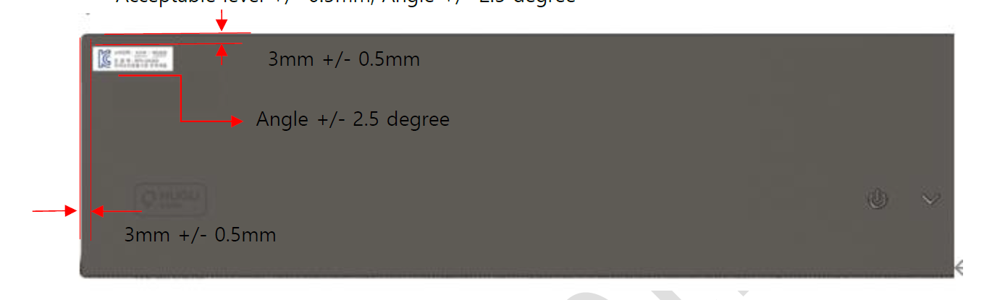
Spec to sticking label
The tolerance is so tight, and the label is easily to out of position with out making. Our factory suggest to change the tolerance to ±2mm.
ALT Feedback : this is same spec for Eagle product. ALT can not accept tolerance to ±2mm

